Slide 1
RADY 403 Case Presentation
Renal Injury in Major Blunt Trauma
Ahmed Mashal, MS4 April 2023

Slide 2
Focused patient history and workup
16 yo female with unremarkable medical history who presented to the ED as red trauma following MVC
On presentation:
Alert and oriented with GCS 15
Hypotensive to 80s/60s and tachycardic to 120s
Complaining of left arm and left leg pain
Deformity to left upper extremity
Tenderness and increased mobility to left pelvic rum
Full thickness laceration and tenderness to left lower extremity
Intact pulses
Received PRBCs x 2, 1unit FFP
X-ray of the pelvis with bilateral rami fracture -> Pelvic binder placed
Ancef ordered for large lacerations and possible open fractures
Fentanyl administered for pain.
Trauma labs ordered and patient transported for additional imaging

Slide 3
List of imaging studies
XR Chest Portable
XR Pelvis AP Portable
CT Head Wo Contrast
CT Maxillofacial Wo Contrast
CT Cervical Spine Trauma
CT Thoracic Spine Wo Contrast
CT Lumbar Spine Wo Contrast
CT Abdomen Pelvis W Contrast
CTA Neck W Contrast
CTA Chest W Contrast
XR Elbow 3 Or More Views
Left XR Forearm
Left XR Trauma Hip
Left XR Tibia Fibula
Left XR Ankle 3 Or More Views
Left XR Foot 2 Views
Left XR Hand 3 Or More Views
Left XR Pelvis 3 Or More Views
XR Wrist 3 Or More Views
Left FL Fluoro < 60 Minutes (No Interp)
XR Pelvis 3 Or More Views
XR Elbow 3 Or More Views Left
XR Clavicle Left
On the following day:
CT Urogram
CT Pelvis Wo Contrast
Many XR imaging of extremities

Slide 4
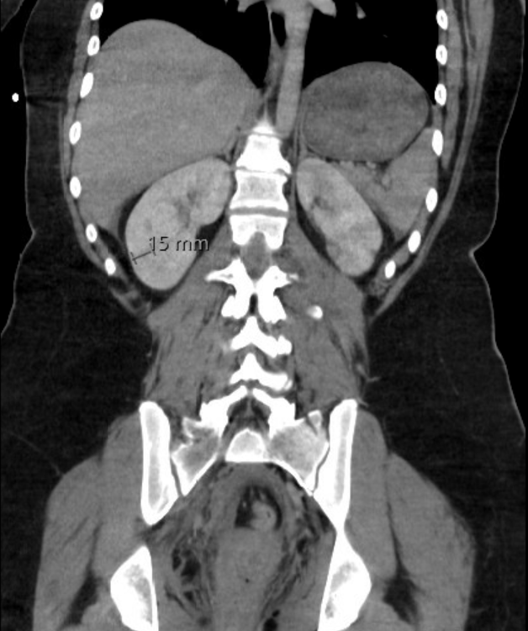
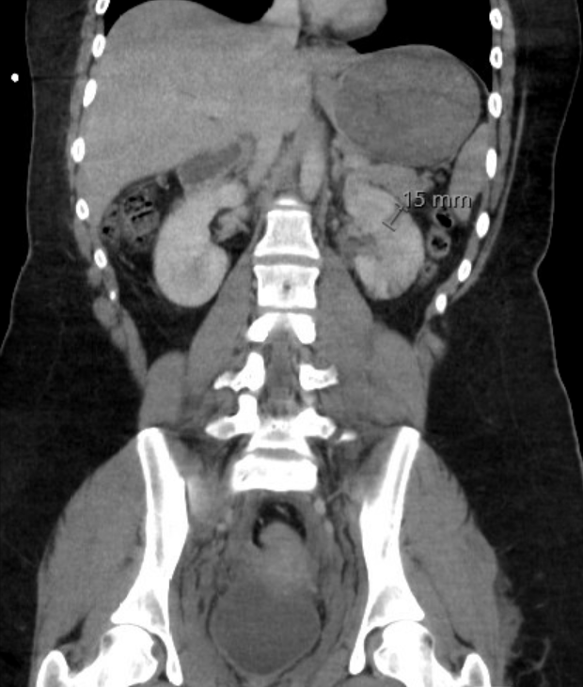
CT Abdomen and Pelvis with Contrast
Multiple bilateral renal lacerations measuring up to 1.5 cm in the left and 1.5 cm in the right

Slide 5
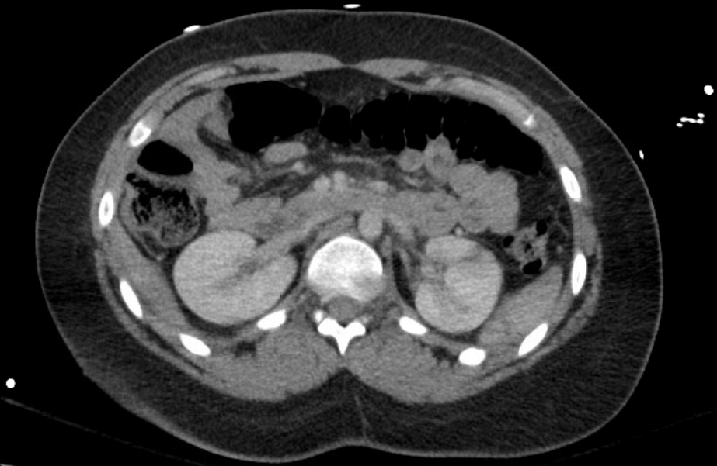
Left Kidney Laceration – Axial View

Slide 6
Pertinent Findings
KIDNEYS/URETERS:
Multiple bilateral renal lacerations measuring up to 1.5 cm in the left and 1.5 cm in the right
No surrounding hematoma
The renal artery and vein appear patent
No surrounding fluid collection suggesting collecting system involvement
Small volume of hemorrhage within the pelvis, but no foci of active extravasation are visualized
Recommended CT Urogram for further evaluation
Patient also had
Bilateral superior and inferior pubic rami fractures.
Multiple lumbar transverse process fractures and fracture of the sacrum

Slide 7
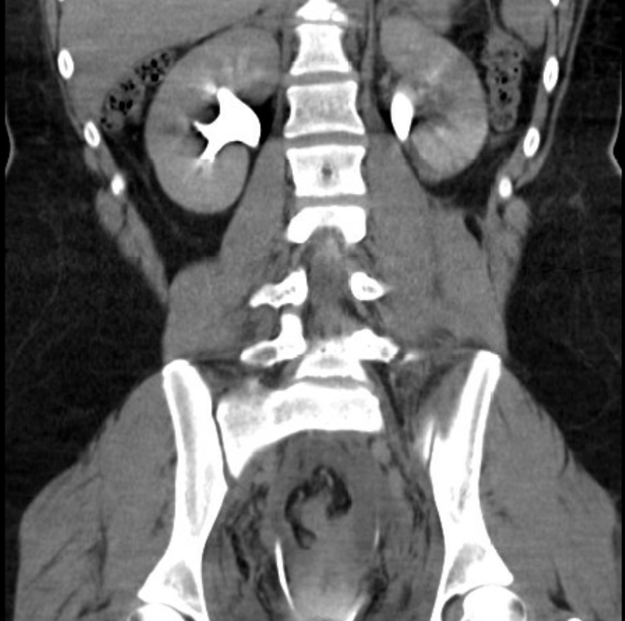
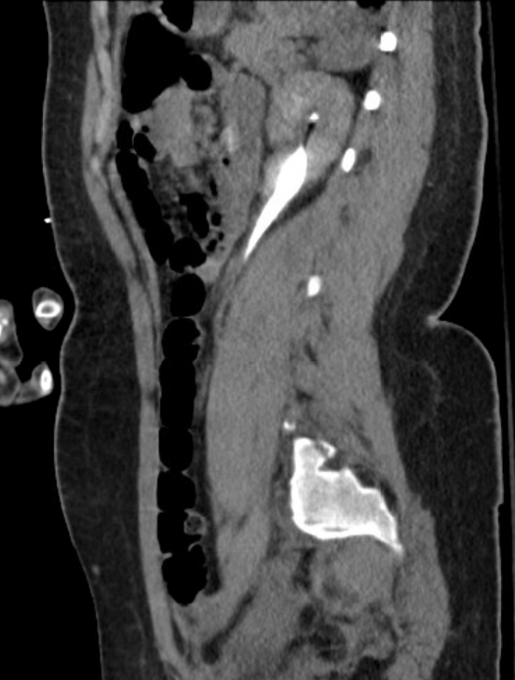
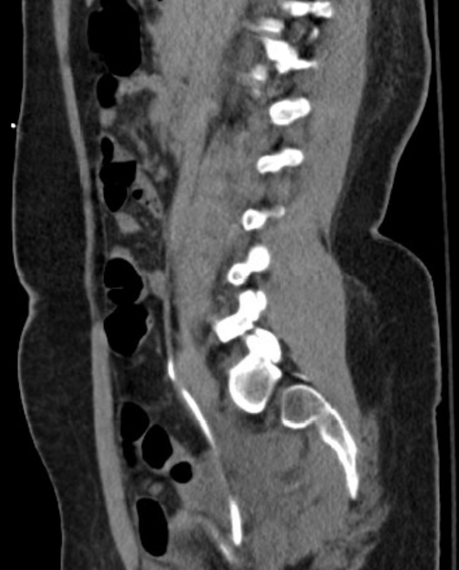
CT Urogram

Slide 8
Pertinent CT Urogram Findings
Nephrographic phase was not performed – limited evaluation of renal parenchyma
Excretory phase performed, well opacified collecting systems and no evidence for collecting system injury
Similar to minimally increased volume of hemorrhage within the pelvis

Slide 9
Patient treatment & outcome
Hypotension resolved with blood and fluid
Kidney injury managed conservatively with appropriate urine output throughout patient stay
Left Closed Intrarticular Distal Humerus Fracture - Placed in long arm splint with side struts
Pelvic fractures (Bilateral Superior & Inferior Pubic Rami Fractures, Right SI widening, Left Sacral Ala fracture) - Stable type injury, no operation needed
Left clavicle fracture – Recommended Sling
Left third, fourth, and fifth metatarsal head fractures; Left fourth metatarsal base fracture: - Possible occult calcaneus fracture - Short leg splint
Left – Open treatment of humeral supracondylar or transcondylar fracture, includes internal fixation, w/intercondylar extension
Discharged on day 12, ambulatory, tolerating pain with PO pain medication, and following with Ortho, physical therapy and occupational therapy

Slide 10
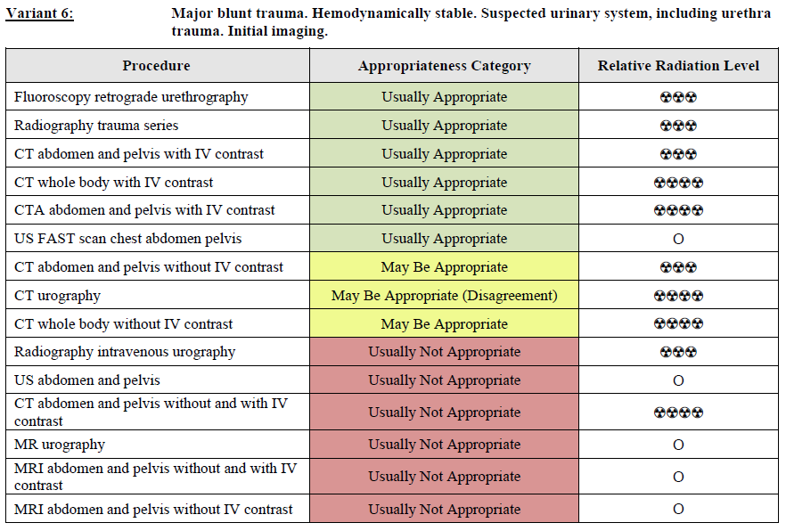
Renal Injury due to Blunt Mechanism
More than 90% of renal injuries are caused by blunt trauma, while 10% are caused by penetrating trauma
Most commonly injured organ in children is the kidney, unlike adults
Signs of renal injury require further evaluation of the collecting system
Initial evaluation with CT abdomen and pelvis with IV contrast is usually appropriate
CT urography may be appropriate
Our patient has kidney injury, hematuria, and pelvic fractures which are indications for additional secretion-phase CT (part of CT urography completed the following day)
Notes:
Ledbetter , S. (2022, July 7). CT in abdominal trauma. The Radiology Assistant : CT in Abdominal Trauma. Retrieved April 13, 2023, from https://radiologyassistant.nl/abdomen/acute-abdomen/ct-in-trauma
“The panel did not agree on recommending imaging with CTU. There is insufficient medical literature to conclude whether or not these patients would benefit from this procedure. Imaging with CTU in this patient population is controversial but may be appropriate. ”

Slide 11
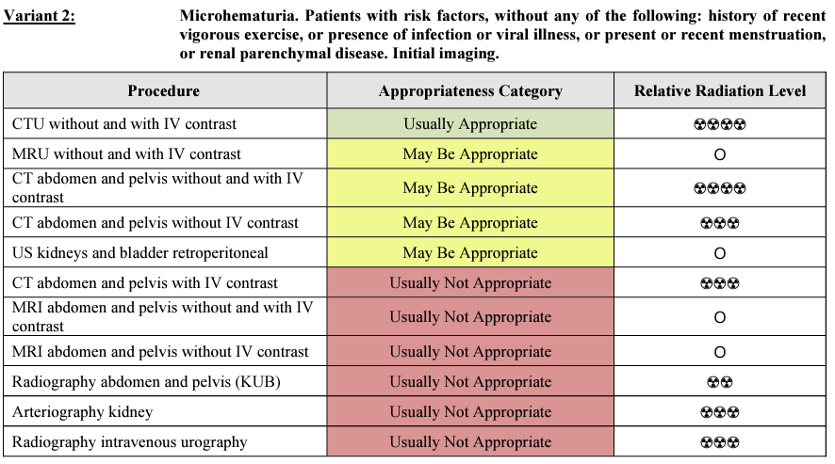
CT Urogram and ACR
Notes:
Wolfman DJ, et all. ACR Appropriateness Criteria® Hematuria. Available at https://acsearch.acr.org/docs/69490/Narrative/. American College of Radiology. Accessed 4/13/2023.

Slide 12
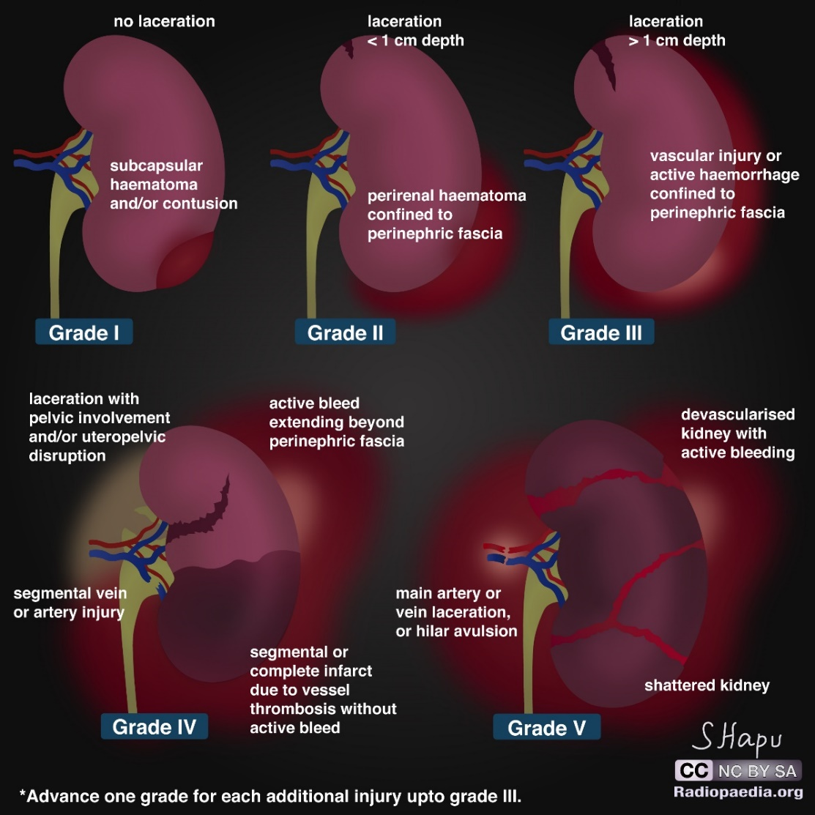
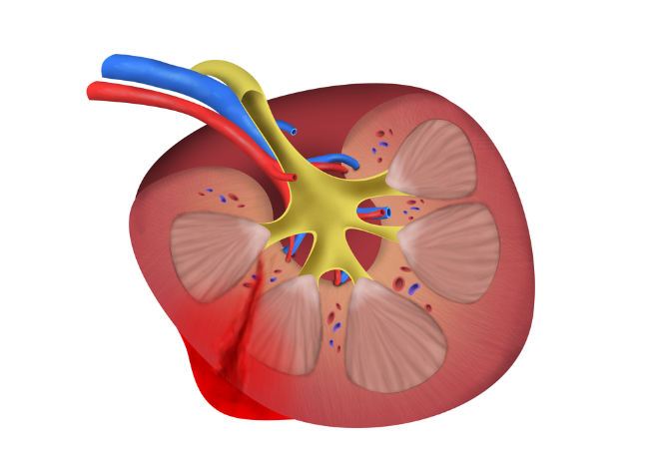
The American Association for the Surgery of Trauma (AAST) Kidney Injury Scale
Our case:
Laceration > 1 cm, not involving the collecting system
No evidence of urine extravasation
No vascular injury or active bleeding (still the same grade if active bleeding confined within the perirenal fascia)
Gaillard F, Niknejad M, Saber M, et al. AAST kidney injury scale. Reference article, Radiopaedia.org (Accessed on 13 Apr 2023) https://doi.org/10.53347/rID-1972
Notes:
Gaillard F, Niknejad M, Saber M, et al. AAST kidney injury scale. Reference article, Radiopaedia.org (Accessed on 13 Apr 2023) https://doi.org/10.53347/rID-1972

Slide 13
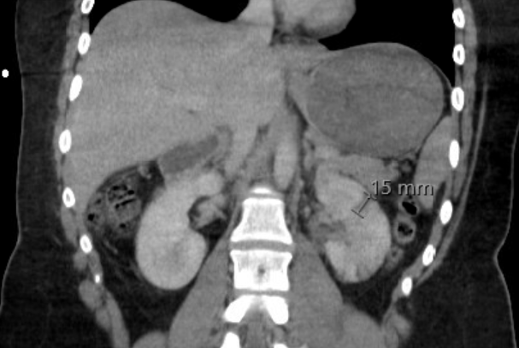
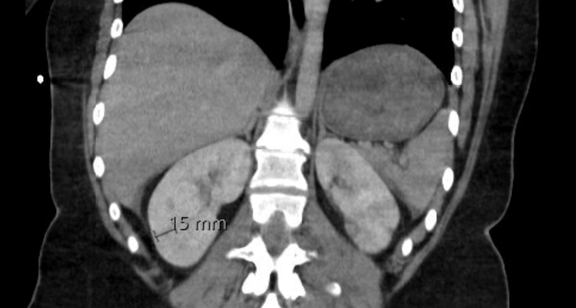
Grade III Kidney Injury Management
Stable kidney injuries are managed conservatively with close monitoring of the patient's vital signs, urine output, and laboratory values, along with strict bed rest and serial imaging (such as CT scans) to assess for any changes in the injury.
IR can be helpful for ongoing bleeding or expanding hematoma
In rare cases, surgery is required for expanding hematoma, persistent bleeding and other complications
Notes:
Reference: Moore, E. E., Cogbill, T. H., Malangoni, M. A., Jurkovich, G. J., Champion, H. R., Gennarelli, T. A., ... & Shackford, S. R. (2018). Organ injury scaling 2018 update: spleen, liver, and kidney. Journal of Trauma and Acute Care Surgery, 85(6), 1119-1122.

Slide 14
Wrap Up
Stable kidney injures are generally managed conservatively
CT abdomen and pelvis with IV contrast is usually appropriate in a hemodynamically stable, major blunt trauma patient with suspected urinary system involvement
AAST Organ Injury Scale categorizes kidney injuries into five grades based on increasing severity:
Grade I: Minor contusion or hematoma without parenchymal laceration.
Grade II: Parenchymal laceration less than 1 cm deep without involvement of the collecting system.
Grade III: Parenchymal laceration greater than 1 cm deep or involving the collecting system, without extravasation.
Grade IV: Parenchymal laceration involving the collecting system with extravasation or vascular injury.
Grade V: Shattered or devascularized kidney.

Slide 15
References
Ledbetter , S. (2022, July 7). CT in abdominal trauma. The Radiology Assistant : CT in Abdominal Trauma. Retrieved April 13, 2023, from https://radiologyassistant.nl/abdomen/acute-abdomen/ct-in-trauma
Shyu JY, et all. ACR Appropriateness Criteria® Major Blunt Trauma. Available at https://acsearch.acr.org/docs/3102405/Narrative/, American College of Radiology. Accessed 4/13/2023.
Wolfman DJ, et all. ACR Appropriateness Criteria® Hematuria. Available at https://acsearch.acr.org/docs/69490/Narrative/. American College of Radiology. Accessed 4/13/2023.
Gaillard F, Niknejad M, Saber M, et al. AAST kidney injury scale. Reference article, Radiopaedia.org (Accessed on 13 Apr 2023) https://doi.org/10.53347/rID-1972
Moore, E. E., Cogbill, T. H., Malangoni, M. A., Jurkovich, G. J., Champion, H. R., Gennarelli, T. A., ... & Shackford, S. R. (2018). Organ injury scaling 2018 update: spleen, liver, and kidney. Journal of Trauma and Acute Care Surgery, 85(6), 1119-1122.

