Slide 1
Sapna Patel April 2023
RADY 403 Teaching File: Developmental Dysplasia of the Hip

Slide 2
Patient history
2 day F presents to PCP
Reported to have “hip clunking” on Newborn Nursery exam
Ex-full term infant, delivered via Cesarean for breech presentation, and otherwise healthy
Physical exam: Right hip clunk noted. Left hip is normal.

Slide 3
List of imaging studies
US hip
6 weeks
3 months
XR pelvis AP and frog leg views
6 months
8 months
12 months

Slide 4
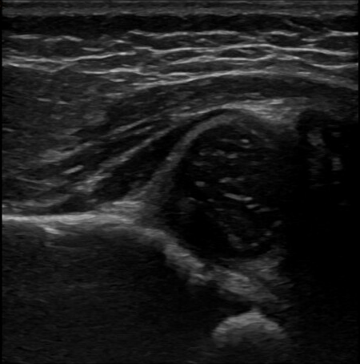
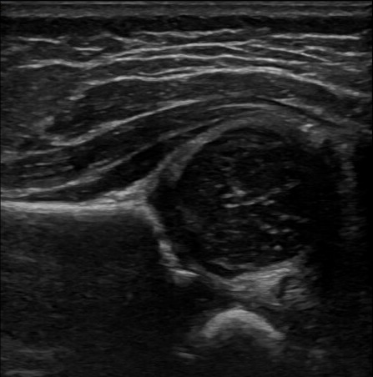
US Hip: 6 weeks old
R
L
Alpha angle = 69 degrees
Alpha angle = 45 degrees
R femoral head coverage approx. 35%
L femoral head coverage approx. 50%
Additional findings: No evidence of subluxation with stress maneuvers bilaterally

Slide 5
Further treatment
Referred to Pediatric Orthopedic clinic, seen the following week
Exam at the time:
Hips demonstrate symmetric wide abduction
Negative Barlow and Ortolani maneuvers
No Galeazzi sign
Fitted with Pavlik harness, instructed to wear 20 hours/day
Notes:
Image Source: https://www.hipclothingau.com/collections/harness-covers

Slide 6
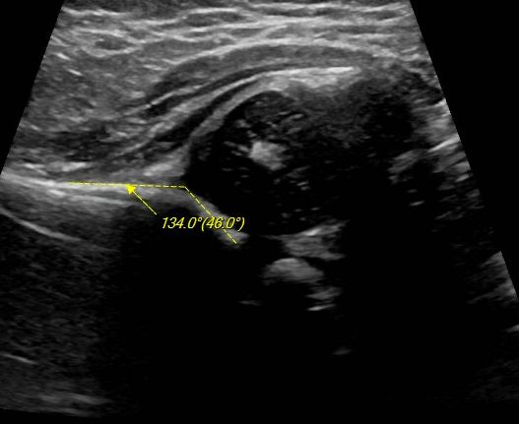
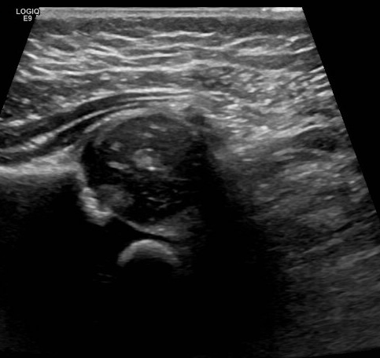
US Hip: 3 months old
R
L
Alpha angle = 60; prev 69
Alpha angle = 46; prev 45
R femoral head coverage approx. 35%
L femoral head coverage approx. 50%
Additional findings: No evidence of subluxation with stress maneuvers bilaterally

Slide 7
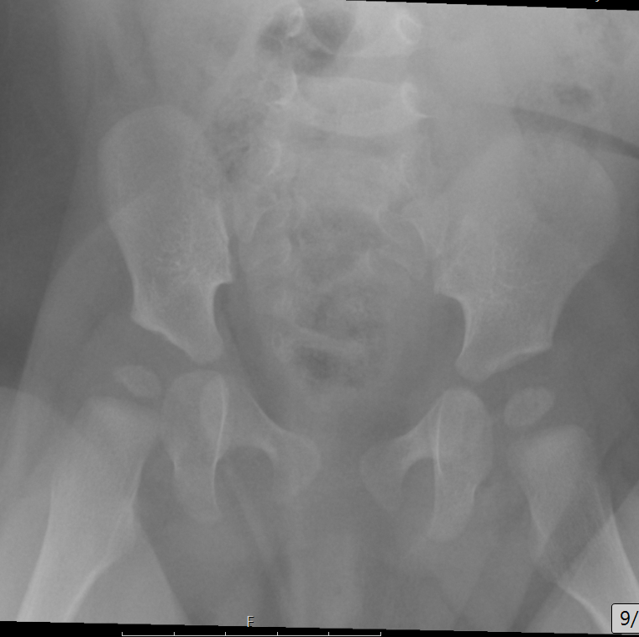
XR Pelvis: 6 months old
***Limited read due to obliquity on AP projection; acetabular angles could not be measured
Mild R lateral subluxation of femoral head
Asymmetric femoral head ossification, right decreased compared to left
Shenton’s arc intact bilaterally

Slide 8
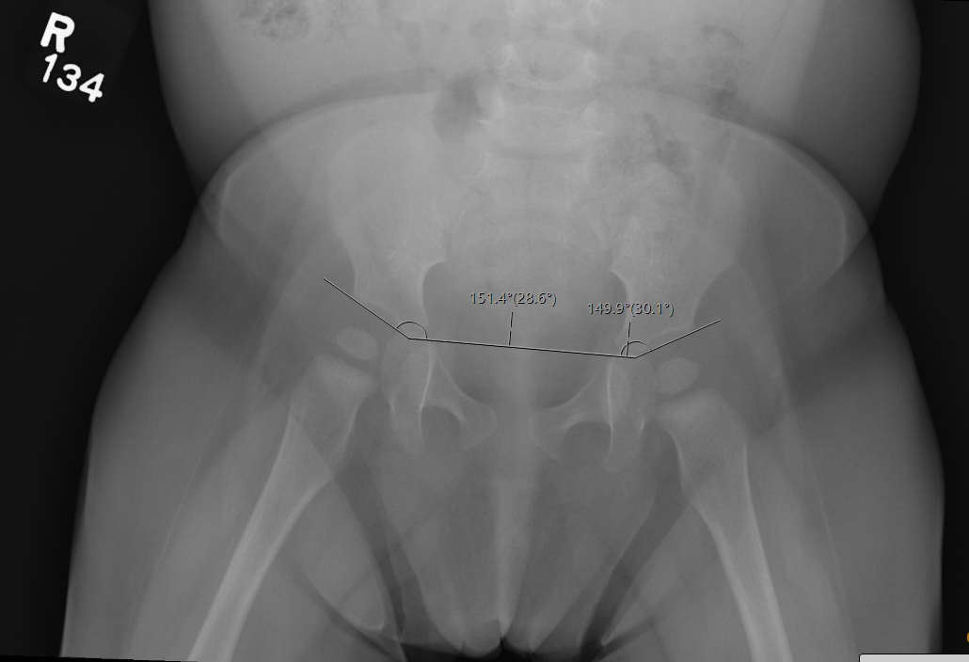
XR Pelvis: 8 months old
Similar mild R lateral subluxation of femoral head
Shenton’s arc intact bilaterally
Continued asymmetric femoral head ossification, right decreased compared to left

Slide 9
XR Pelvis: 8 months old
R Acetabular angle = 30 degrees
L Acetabular angle = 29 degrees

Slide 10
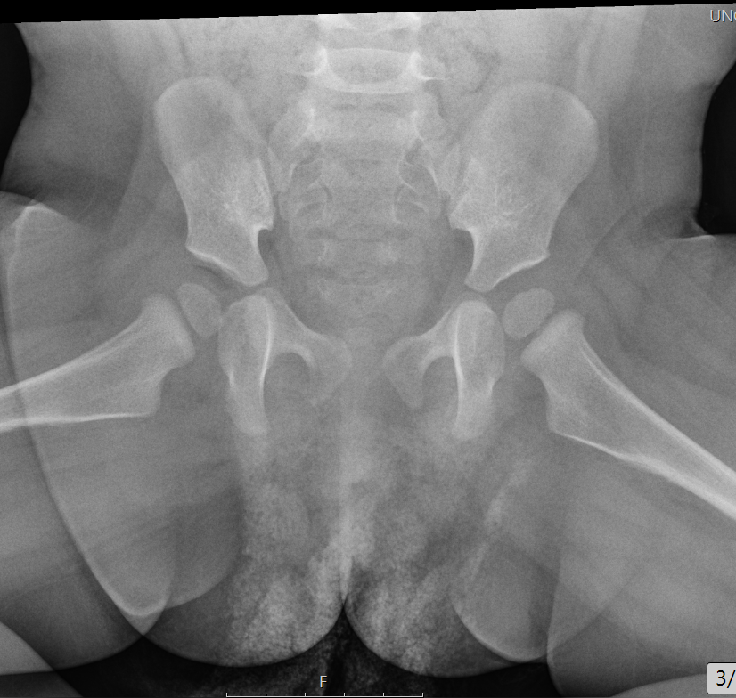
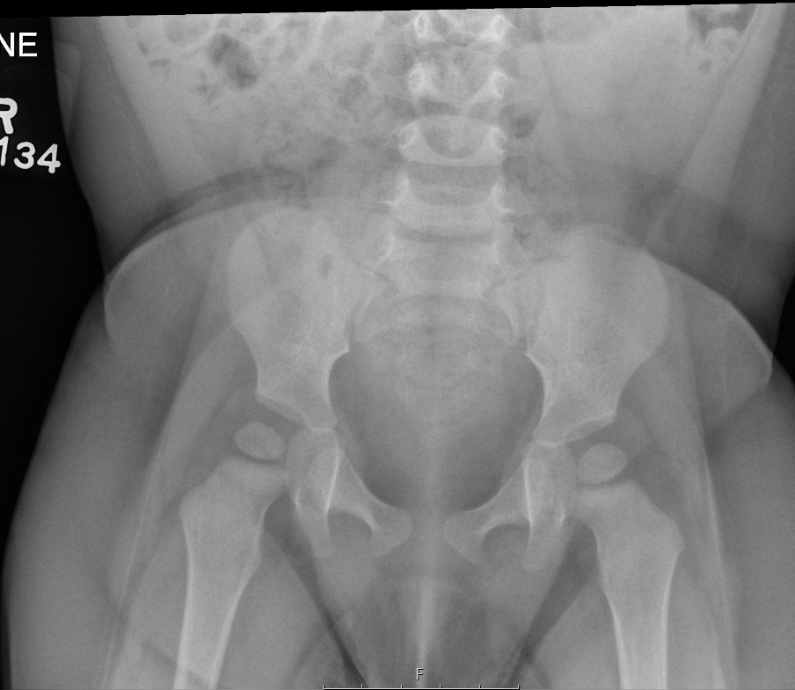
XR Pelvis: 12 months
R acetabular angle = 30 degrees, unchanged
L acetabular angle = 28 degrees, previously 29 degrees
Similar asymmetric R<L femoral head ossification
Shenton’s arc intact bilaterally

Slide 11
Patient treatment or outcome
Continued bracing at night and during naps after second ultrasound
12 mo imaging in March 2023 with acetabular indices deemed within normal limits and bracing was discontinued per Orthopedics
Will be followed radiographically

Slide 12
Discussion: Developmental dysplasia of the hip (DDH)
Refers to abnormal development and configuration of the acetabulum and increased ligamentous activity around the hip
Recurrent subluxation or dislocation of the hip secondary to the above
Risk factors: Females>Males (9:1), breech delivery, positive family history of DDH
Development of the femoral head and acetabulum are interconnected
At birth – femoral head and acetabulum are primarily cartilaginous
Postnatally – acetabulum continues to develop
Growth of labrum which surrounds the bony acetabulum deepens the socket
Femoral head not in the acetabulum can delay ossification of femoral head
L>R hip affected, minority of patients affected bilaterally

Slide 13
Discussion: DDH
Exam findings: asymmetric gluteal folds, limited abduction when flexed, positive ”clunk” felt on Barlow (dislocation)/Ortolani (relocation), leg length discrepancy
After 3 mo of age – limitation in abduction is the most reliable sign, decreasing sensitivity of the Barlow and Ortolani signs
Early detection important, late presentation is a negative prognostic factor
Early detection allows time to utilize nonsurgical brace/harness prior to ambulation
Late presentation likely to require complex treatment, surgical intervention, and long-term complications (e.g., early degenerative joint disease)
Part of routine neonatal screening
Many borderline “abnormal” hips spontaneously normalize after neonatal period on monitoring
Notes:
DDH is the cause of up to a third of all total hip arthroplasties performed in patients <60 years of age,

Slide 14
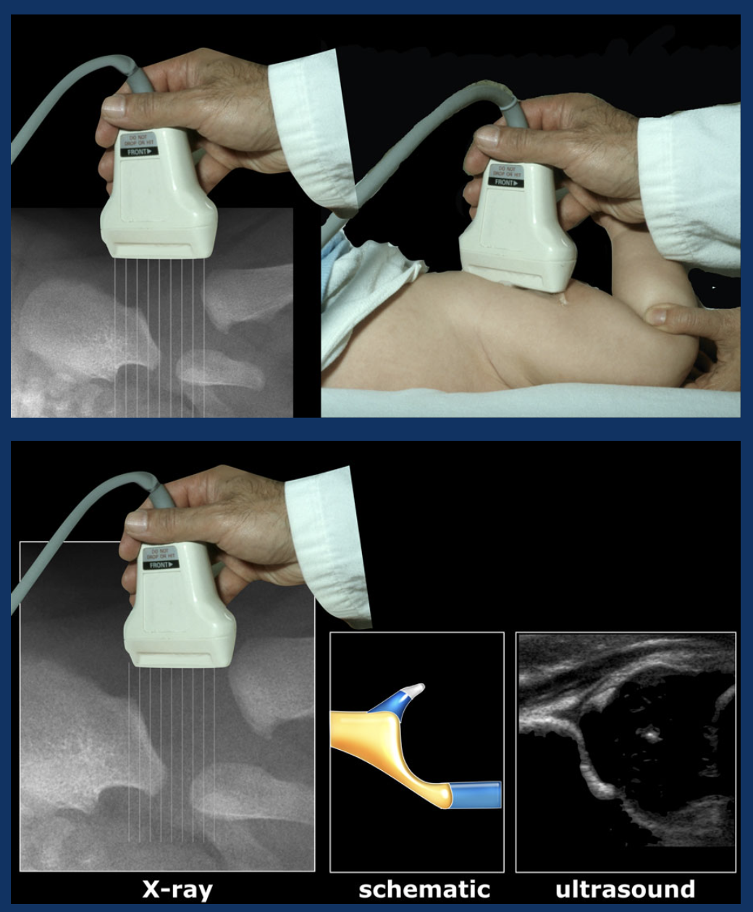
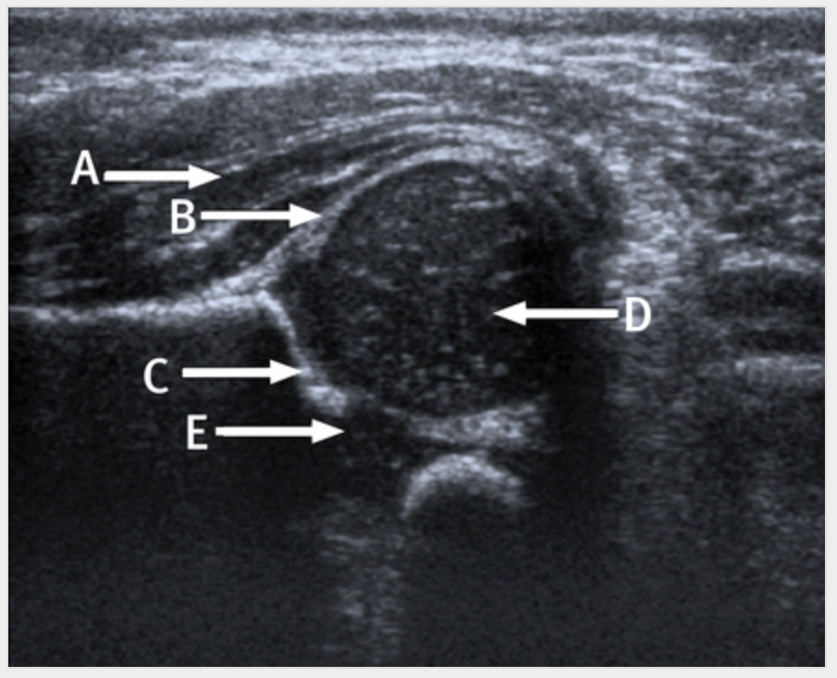
Discussion: US coronal view
Gluteal muscles
Labrum of acetabulum
Femoral head
Acetabulum
Triradiate cartilage
Notes:
Image Sources:
Hip sonography. Diagnosis and management of infant hip dysplasia.by Graf R. Berlin: Springer; 2006.
Muthukumarasamy S, Sinha C K, Hedayati B. Coronal ultrasound anatomy of a normal hip in a newborn baby BMJ 2012; 345 :e5261 doi:10.1136/bmj.e5261

Slide 15
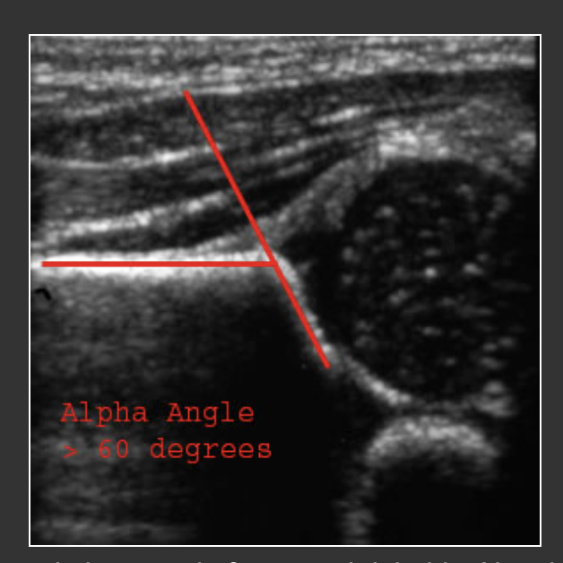
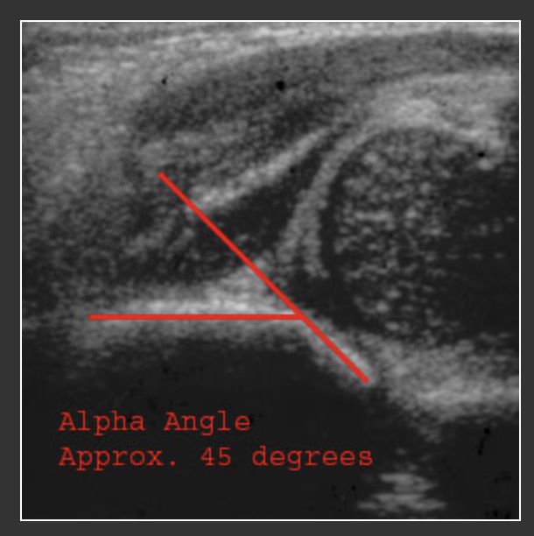
Discussion: DDH US Findings
On coronal views: The alpha angle is formed by lines drawn through the roof of the acetabulum and the the straight portion of the iliac bone. A normal alpha angle measures > 60 degrees (55 degrees in newborns).
Normal hip
Hip dysplasia
Notes:
Image source: https://introductiontoradiology.net/courses/rad/peds/ms_webpages/ms3bddh.html

Slide 16
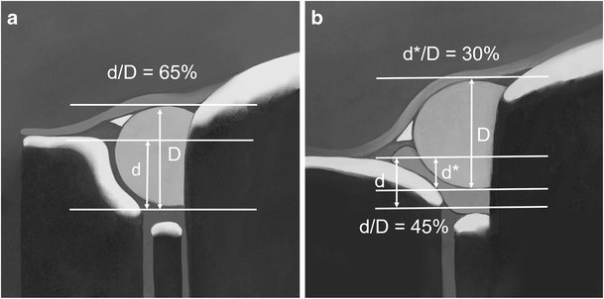
Discussion: DDH US Findings
Normal R hip
L hip dysplasia
On coronal views: comparing femoral head coverage to produce a fraction
d) Bony acetabular depth
D) cartilaginous femoral head produces a fraction
Notes:
Image source: Harcke, H. T., & Pruszczynski, B. (2017). Hip ultrasound for developmental dysplasia: the 50% rule. Pediatric radiology, 47, 817-821

Slide 17
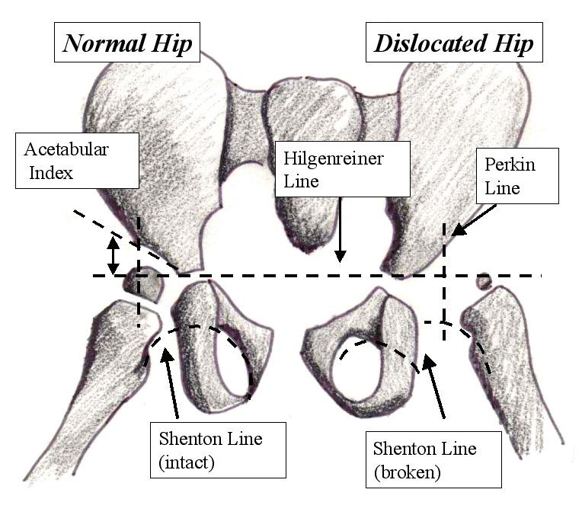
Discussion: DDH Radiograph Findings
Hilgenreiner line
Horizontal through bilateral triradiate cartilages, touching inferior medial aspect of each acetabulum
Perkin line
Perpendicular to Hilgenreiner
Through superolateral corner of acetabulum
Femoral head should lie medial to Perkin line in lower inner quadrant
Dislocated femoral head may be lateral and even in upper quadrant of this cross
Acetabular index
A second line is then drawn connecting the inferior medial and superolateral aspects of the acetabulum, outlining the acetabular roof
The angle made between these two lines is the acetabular angle.
~30 degrees in newborns, decreases with age
Acetabular angles abnormally increased in DDH
Shenton arc
Arc connecting medial metaphysis of femur and inferior portion of superior pubic ramus
Discontinuous arc in DDH
Notes:
Image source: http://www.learningradiology.com/notes/bonenotes/conghipdysplasiapage.htm

Slide 18
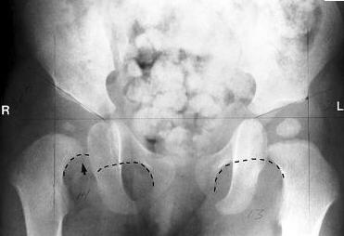
Discussion: DDH AP Radiograph Findings
Shenton’s arc intact interrupted
Notes:
Image source: https://www.orthobullets.com/pediatrics/4118/developmental-dysplasia-of-the-hip-ddh

Slide 19
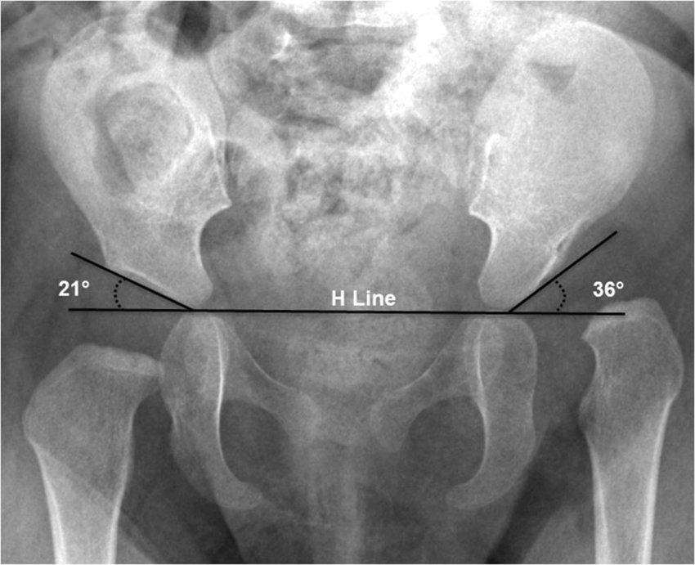
Discussion: DDH AP Radiograph Findings
Abnormal acetabular angle > 30 degrees
Shenton’s arc intact interrupted
Notes:
Image source: https://www.researchgate.net/figure/Acetabular-index-on-radiography-Anteroposterior-radiography-in-an-8-month-old-girl-with_fig9_337009090

Slide 20
Discussion: DDH ACR Appropriateness Criteria
Last revised in 2018, updated guidelines to be released soon

Slide 21
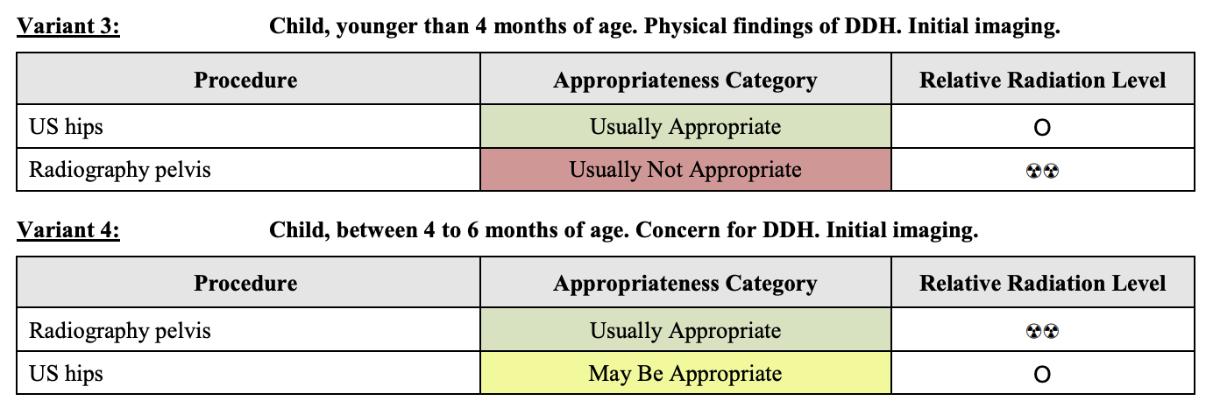
Discussion: DDH ACR Appropriateness Criteria
Majority spontaneously normalize and short delay in intervention has no negative impact on outcome AAP recommends screening at 4-6 weeks.
Waiting until 4-6 weeks, allows time for neonatal physiologic immaturity and laxity to normalize. Still a high rate of false positives. AAP recommends selective US in high-risk group (breech F, positive fam hx F, breech M, inconclusive PE)
Positive physical exam findings.
Late presentation is uncommon. Physical exam findings unreliable and imaging often required to confirm diagnosis. After appearance of ossific nucleus of femoral head, pelvic radiography becomes preferred imaging modality.
Equivocal exam: soft click, mild asymmetry, no Barlow/Ortolani sign
Positive exam: positive Barlow/Ortolani sign
Notes:
Image source: https://acsearch.acr.org/docs/69437/Narrative/

Slide 22
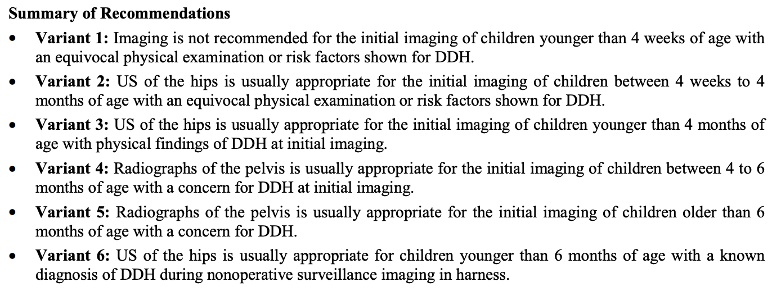
Discussion: DDH ACR Appropriateness Criteria
Notes:
Image source: https://acsearch.acr.org/docs/69437/Narrative/

Slide 23
Top Three Takeaways
Imaging modality of hip US vs. XR decision can be made by assessing patient’s age in conjunction with physical exam findings
Early imaging findings can be false-positives and lead to overtreatment of patients that may otherwise normalize without intervention
Tracking specific measurements over time (e.g., alpha angle, acetabular index, femoral head coverage) can help assess severity and progression of DDH
Notes:
US can be used to confirm concentric hip reduction [74,75], assess treatment response [73,76-79], and identify signs of therapy failure [80]. Predictors of failure include low postreduction alpha angle and

Slide 24
References
Committee on Quality Improvement, Subcommittee on Developmental Dysplasia of the Hip. (2000). Clinical practice guideline: early detection of developmental dysplasia of the hip. Pediatrics, 105(4), 896-905.
Expert Panel on Pediatric Imaging:, Nguyen, J. C., Dorfman, S. R., Rigsby, C. K., Iyer, R. S., Alazraki, A. L., Anupindi, S. A., Bardo, D. M. E., Brown, B. P., Chan, S. S., Chandra, T., Garber, M. D., Moore, M. M., Pandya, N. K., Shet, N. S., Siegel, A., & Karmazyn, B. (2019). ACR Appropriateness Criteria® Developmental Dysplasia of the Hip-Child. Journal of the American College of Radiology : JACR, 16(5S), S94–S103. https://doi.org/10.1016/j.jacr.2019.02.014
Harcke, H. T., & Pruszczynski, B. (2017). Hip ultrasound for developmental dysplasia: the 50% rule. Pediatric radiology, 47, 817-821.
LeBa, T. B., Carmichael, K. D., Patton, A. G., Morris, R. P., & Swischuk, L. E. (2015). Ultrasound for infants at risk for developmental dysplasia of the hip. Orthopedics, 38(8), e722-e726.
Radiology Departement of the Maastricht University Hospital and the Alrijne hospital in the Netherlands (n.d.). Developmental Dysplasia of the Hip Ultrasound examination. Radiology Assistant. Retrieved April 13, 2023, from https://radiologyassistant.nl/pediatrics/hip/developmental-dysplasia-of-the-hip-ultrasound
Towbin, A.J., Chapter 7 - Musculoskeletal, Editor(s): Donnelly, L.F., Fundamentals of Pediatric Imaging (Third Edition), Academic Press, 2022, Pages 175-256, ISBN 9780128222553, https://doi.org/10.1016/B978-0-12-822255-3.00009-5.

